Slide 1
Thevenin’s Theorem
Thevenin’s theorem states that a linear two-terminal(load terminal) circuit can be replaced by an equivalent circuit consisting of a voltage source VTh in series with a resistor RTh, where VTh is the open-circuit voltage at the terminals and RTh is the input or equivalent resistance at the terminals when the independent sources are disabled by their internal impedances.
Voltage will be s.c. and current source will be o.c.

Slide 2
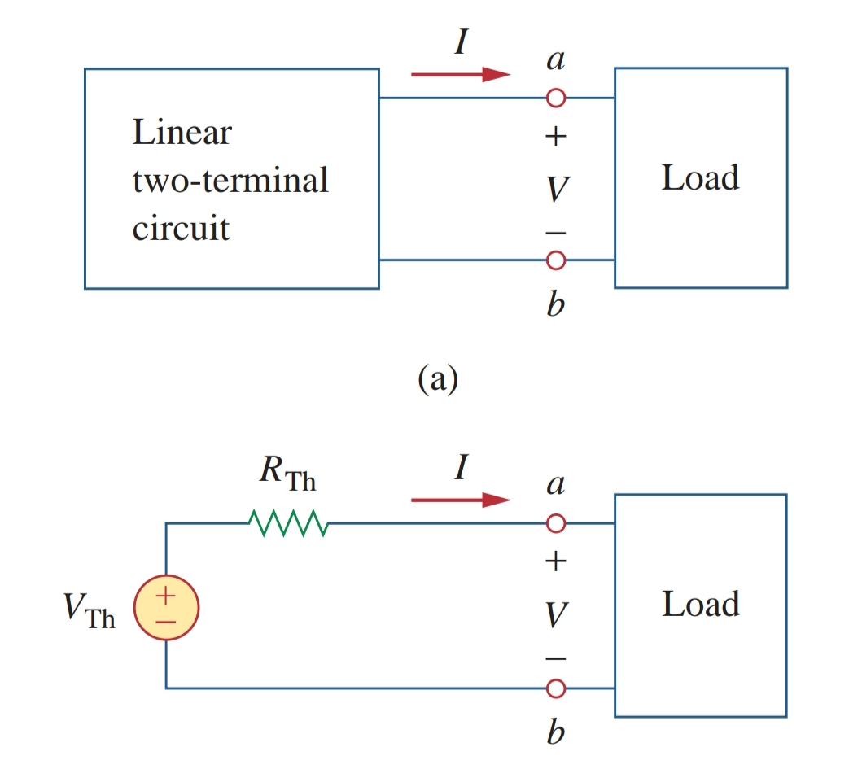

Slide 3
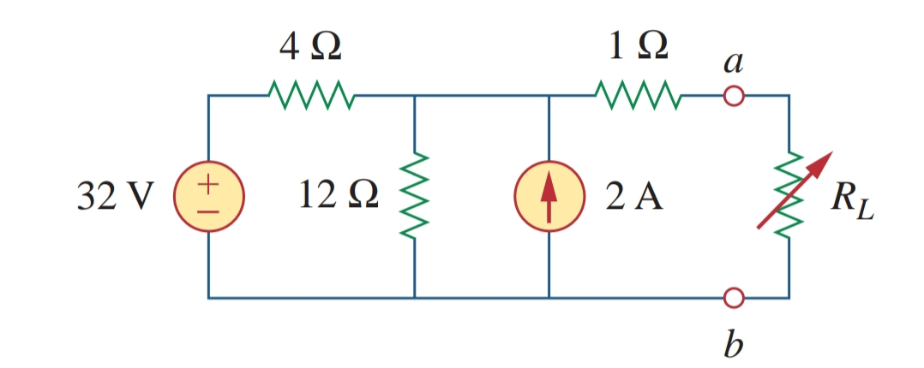
QUES:-

Slide 4
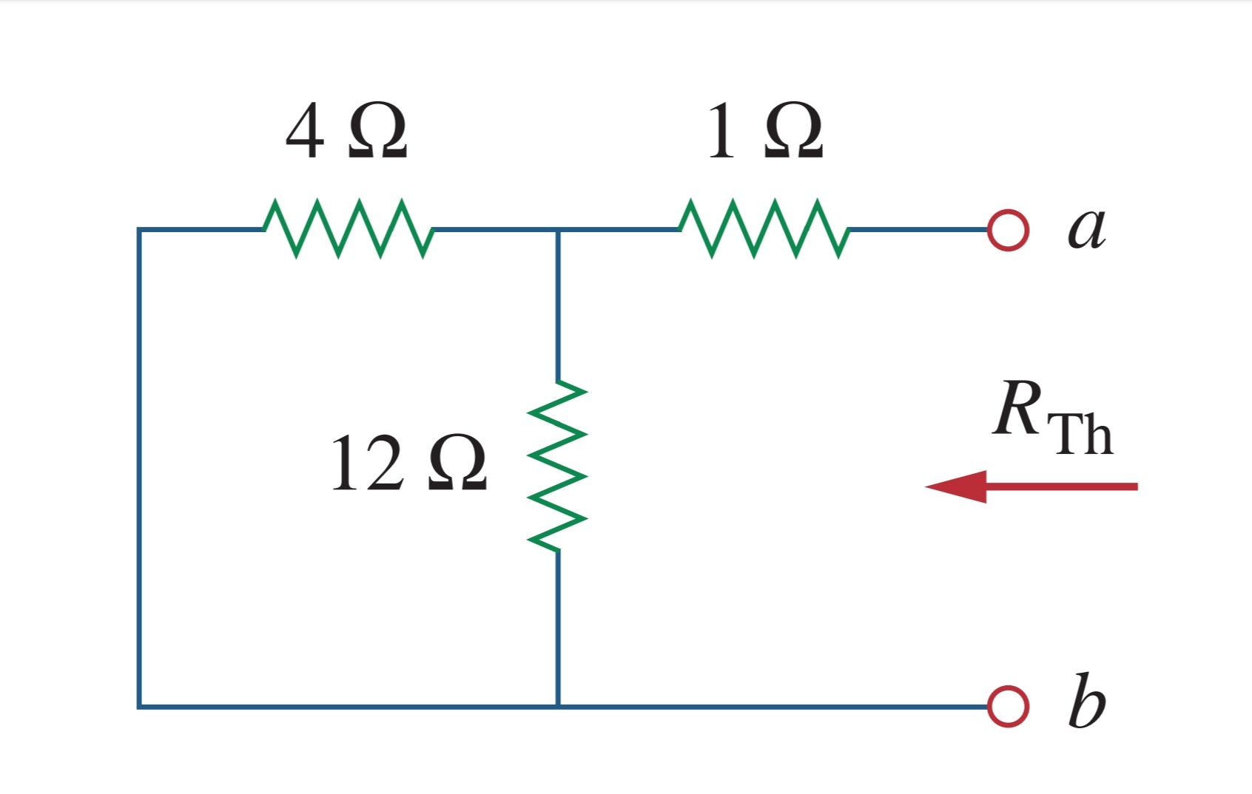
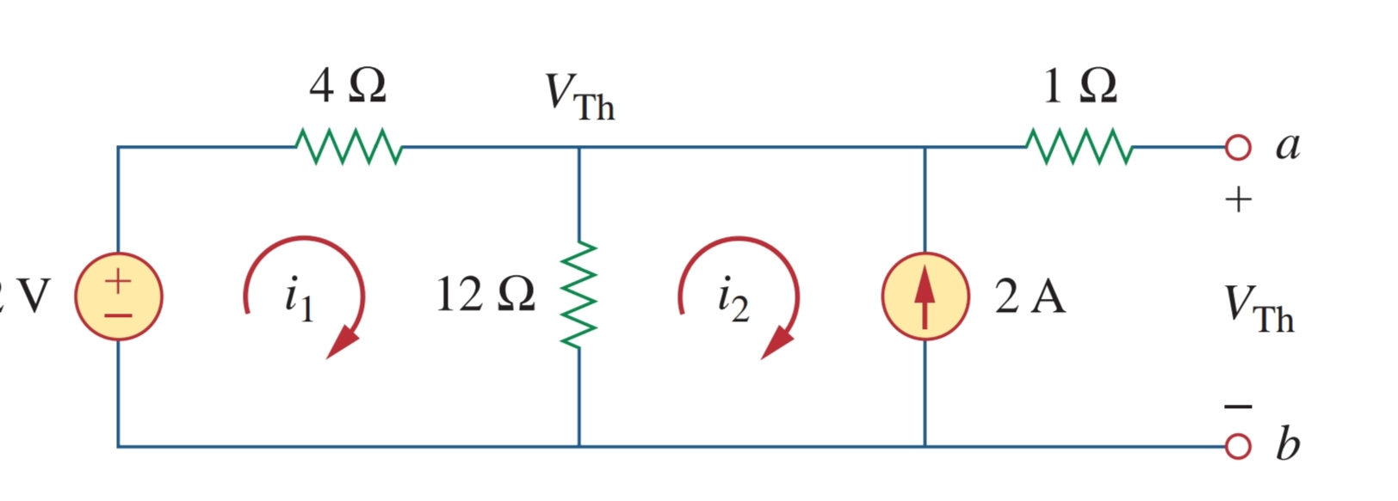

Slide 5
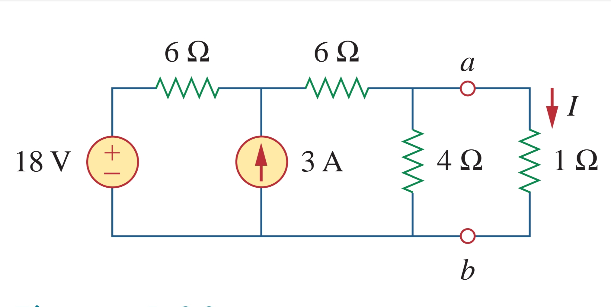
Ques2-

Slide 6
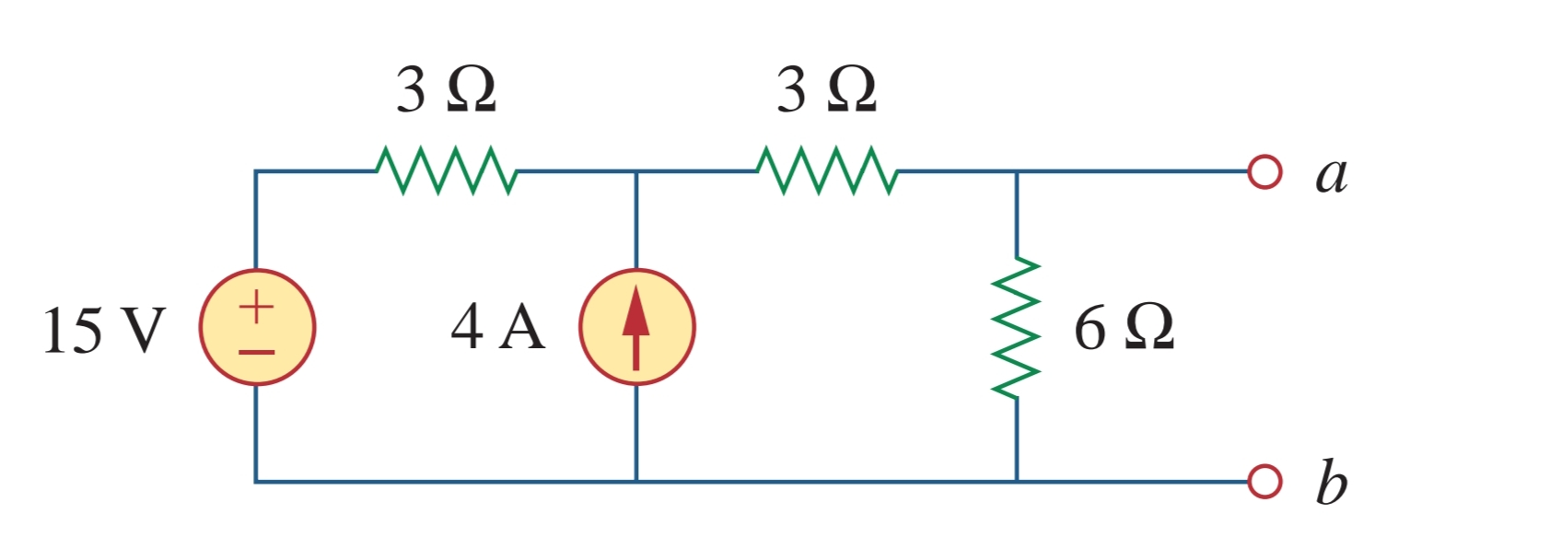
Ques3-

